Slide 1
Introduction to MongoDB
Wang Bo

Slide 2

Background
Creator: 10gen, former doublick
Name: short for humongous (芒果)
Language: C++

Slide 3
What is MongoDB?
Defination: MongoDB is an open source, document-oriented database designed with both scalability and developer agility in mind. Instead of storing your data in tables and rows as you would with a relational database, in MongoDB you store JSON-like documents with dynamic schemas(schema-free, schemaless).

Slide 4
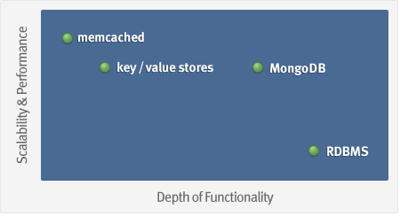
What is MongoDB?
Goal: bridge the gap between key-value stores (which are fast and scalable) and relational databases (which have rich functionality).

Slide 5
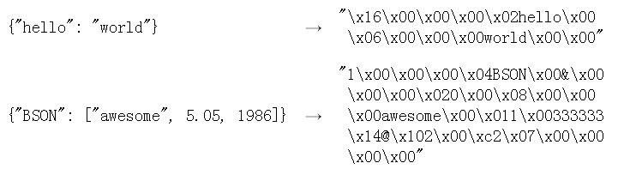
What is MongoDB?
Data model: Using BSON (binary JSON), developers can easily map to modern object-oriented languages without a complicated ORM layer.
BSON is a binary format in which zero or more key/value pairs are stored as a single entity.
lightweight, traversable, efficient

Slide 6
Four Categories
Key-value: Amazon’s Dynamo paper, Voldemort project by LinkedIn
BigTable: Google’s BigTable paper, Cassandra developed by Facebook, now Apache project
Graph: Mathematical Graph Theorys, FlockDB twitter
Document Store: JSON, XML format, CouchDB , MongoDB

Slide 7
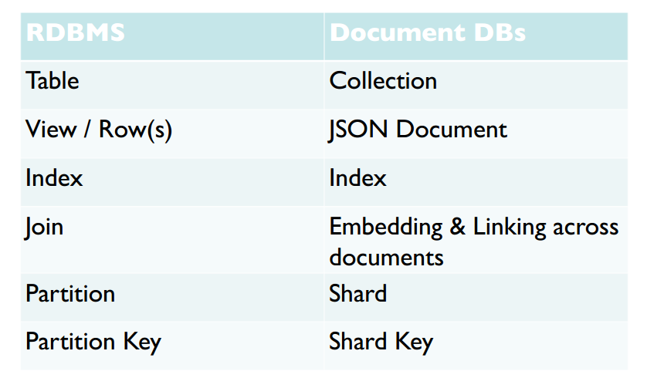
Term mapping

Slide 8
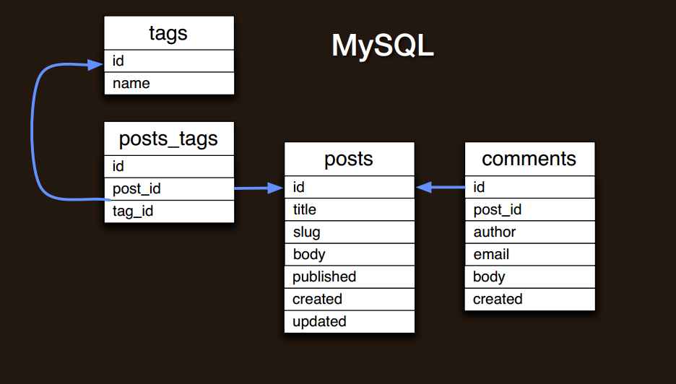
Schema design
RDBMS: join

Slide 9
Schema design
MongoDB: embed and link
Embedding is the nesting of objects and arrays inside a BSON document(prejoined). Links are references between documents(client-side follow-up query).
"contains" relationships, one to many; duplication of data, many to many

Slide 10
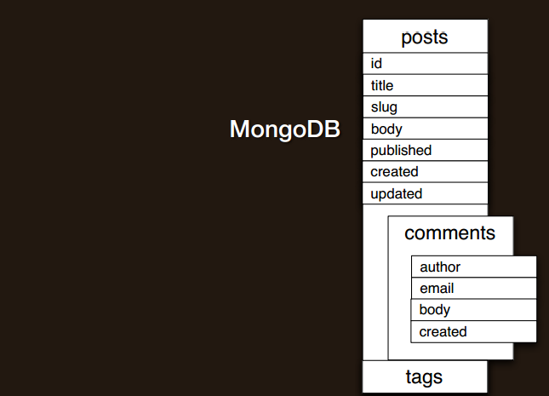
Schema design

Slide 11
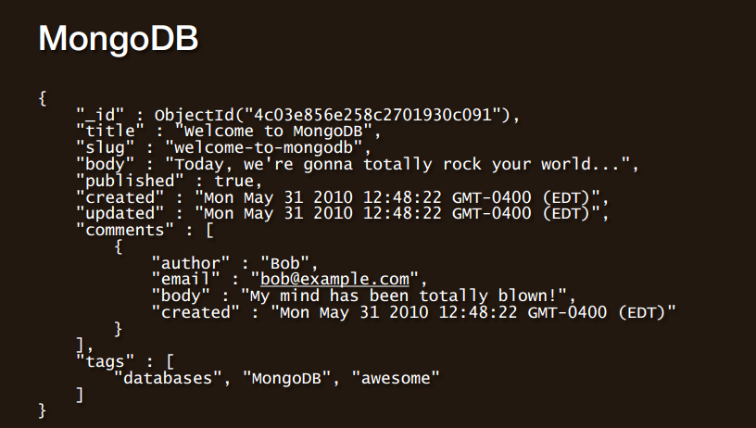
Schema design

Slide 12
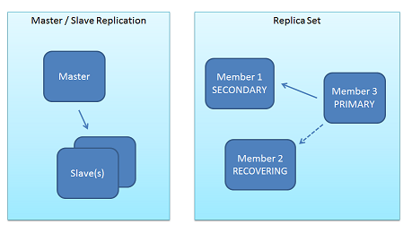
Replication
Replica Sets and Master-Slave
replica sets are a functional superset of master/slave and are handled by much newer, more robust code.

Slide 13
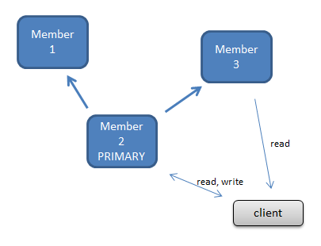
Replication
Only one server is active for writes (the primary, or master) at a given time – this is to allow strong consistent (atomic) operations. One can optionally send read operations to the secondaries when eventual consistency semantics are acceptable.

Slide 14
Why Replica Sets
Data Redundancy
Automated Failover
Read Scaling
Maintenance
Disaster Recovery(delayed secondary)

Slide 15
Replica Sets experiment
bin/mongod --dbpath data/db --logpath data/log/hengtian.log --logappend --rest --replSet hengtian
rs.initiate({
_id : "hengtian",
members : [
{_id : 0, host : "lab3:27017"},
{_id : 1, host : "cms1:27017"},
{_id : 2, host : "cms2:27017"}
]
})

Slide 16
Sharding
Sharding is the partitioning of data among multiple machines in an order-preserving manner.(horizontal scaling )
Machine 1 | Machine 2 | Machine 3
Alabama → Arizona | Colorado → Florida | Arkansas → California
Indiana → Kansas | Idaho → Illinois | Georgia → Hawaii
Maryland → Michigan | Kentucky → Maine | Minnesota → Missouri
Montana → Montana | Nebraska → New Jersey | Ohio → Pennsylvania
New Mexico → North Dakota | Rhode Island → South Dakota | Tennessee → Utah
 | Vermont → West Virgina | Wisconsin → Wyoming

Slide 17
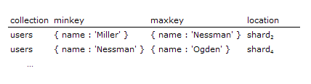
Shard Keys
Key patern: { state : 1 }, { name : 1 }
must be of high enough cardinality (granular enough) that data can be broken into many chunks, and thus distribute-able.
A BSON document (which may have significant amounts of embedding) resides on one and only one shard.

Slide 18
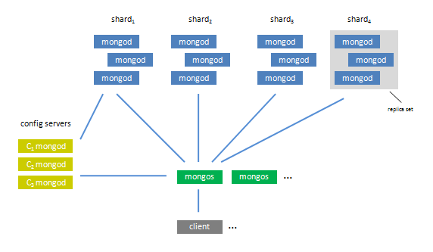
Sharding
The set of servers/mongod process within the shard comprise a replica set

Slide 19
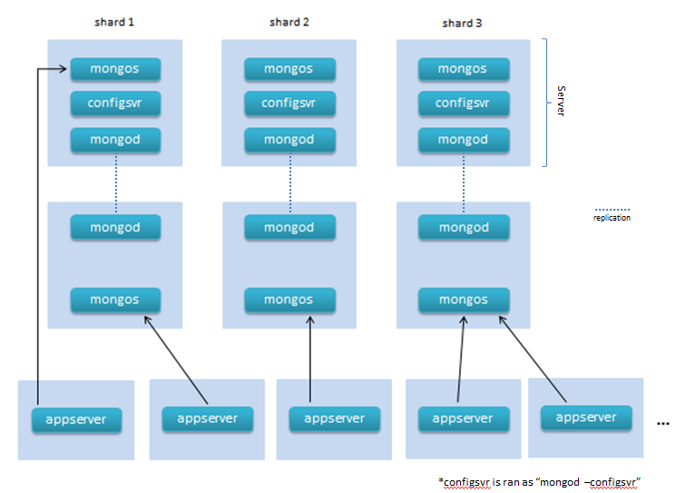
Actual Sharding

Slide 20
Replication & Sharding conclusion
sharding is the tool for scaling a system, and replication is the tool for data safety, high availability, and disaster recovery. The two work in tandem yet are orthogonal concepts in the design.

Slide 21
Map reduce
Often, in a situation where you would have used GROUP BY in SQL, map/reduce is the right tool in MongoDB.
experiment

Slide 22
Install
$ wget http://downloads.mongodb.org/osx/mongodb-osx-x86_64-1.4.2.tgz
$ tar -xf mongodb-osx-x86_64-1.4.2.tgz
mkdir -p /data/db
mongodb-osx-x86_64-1.4.2/bin/mongod

Slide 23





Who uses?

Slide 24
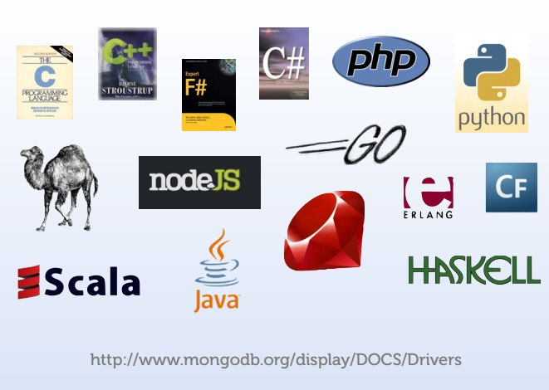
Supported languages

Slide 25
Thank you

